Slide 1
EMBEDDED SYSTEM DESIGN PROJECT ESE-4009 FINALIZING AND ORDERING HARDWARE COMPONENTS
Submitted by:-
Gurdeep Singh (C0751603)
EMBT 4th SEM

Slide 2
IoT based Visitor Counter using Beaglebone Black
LIST OF HARDWARE COMPONENTS USED IN THE PROJECT ARE LISTED BELOW:
BeagleBone Black
Ultrasonic sensors
Temperature Sensor
Motor Driver
DC Motor
Arduino nano
Buzzer
Wi-Fi Module
LCD (16x2)

Slide 3
Wall Mount Adapter
Electronic Components Kit
Soldering Iron kit with Multi Meter
Jumper Wires and Bread Board

Slide 4
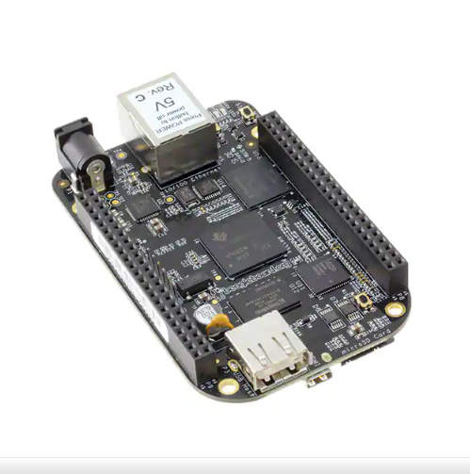
Beaglebone Black Rev C

Slide 5
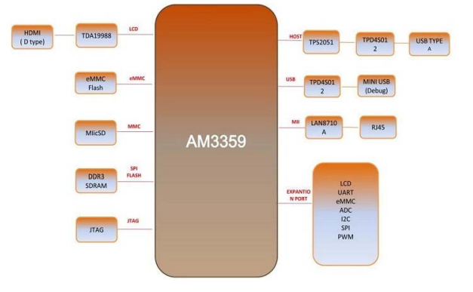
Block diagram

Slide 6
Beagleboard is compact, low-cost, open-source Linux computing platforms that
can be used to build complex applications that interface high-level software
and low-level electronic circuits.
These are ideal platforms for prototyping project and product designs that take
advantage of the power and freedom of Linux, combined with direct access to
input/output pins and buses, allowing you to interface with electronics components,
modules, and USB devices.
BeagleBone Black Rev C is a development kit based on an AM335x processor which
integrates an ARM Cortex™-A8 core operating at up to 1GHz and has abundant
peripheral devices.
BeagleBone Black Rev C is designed to satisfy the different requirements of various
fields including game devices, home and industrial automation, consumer medical
devices, printers, intelligent tolling systems, weighing systems of intelligent
vending machine, educational terminals and high-end toys.

Slide 7
Hardware Features
General Specifications:
Dimensions: 86.36 mm×54.61mm
Operation Temperature: 0 ~ 70℃
Operating Humidity: 20% ~ 90% (Non-Condensing)
Power Supply: 5V/0.35A
AM335x Processor:
Integrating 1GHz ARM Cortex™-A8 core
Integrating NEON™ SIMD coprocessor
Integrating SGX530 graphics engine
Integrating programmable real-time unit subsystem
Integrating 32KB instruction buffer and 32KB data buffer with single-error detection (parity)
Integrating 256KB L2 cache with error-check code

Slide 8
On-Board Memories
4GB 8-bit eMMC on-board flash storage (rev. 3)
512MB DDR3 SDRAM
On-Board Interfaces:
1 HDMI D type interface (16-bit color with audio output)
1 LCD interface (24-bit output, extended by P8 interface)
1 10/100M Ethernet (RJ45 connector)
1 high-speed USB 2.0 OTG interface with PHY (Mini USB type-B connector)
1 high-speed USB 2.0 HOST interface with PHY (USB type-A connector)
1 TF card slot (SD/MMC)
1 3-line debugging serial interface (6-pin 2.54-pitch connector)
1 HDMI type-D interface
1 expansion interface for LCD, UART, eMMC, ADC, I2C, SPI and PWM
1 JTAG interface (optional item, 20-pin standard interface, no connector mounted by default)

Slide 9
Buttons & LEDs:
1 boot device selection button
1 power button
1 reset button
1 LED power indicator
4 user custom indicators

Slide 10
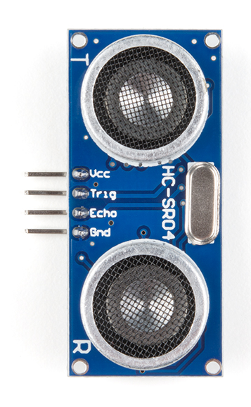
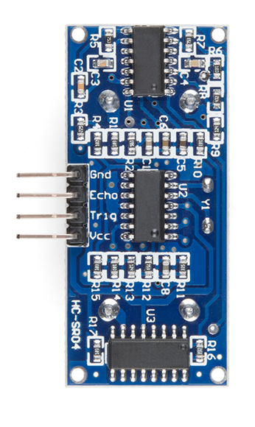
Ultrasonic sensors

Slide 11
Ultrasonic ranging module HC - SR04 provides 2cm - 400cm non-contact
measurement function, the ranging accuracy can reach to 3mm.
The modules includes ultrasonic transmitters, receiver and control circuit.
The basic principle of work:
(1) Using IO trigger for at least 10us high level signal
(2) The Module automatically sends eight 40 kHz and detect whether there
is a pulse signal back.
(3) IF the signal back, through high level , time of high output IO duration
is the time from sending ultrasonic to returning.
Test distance = (high level time×velocity of sound (340M/S) / 2.
This sensor has additional control circuitry that can prevent inconsistent "bouncy" data depending on the application.

Slide 12
Hardware Features
Working Voltage - DC 5 V
Working Current - 15mA
Working Frequency - 40Hz
Max Range - 4m
Min Range - 2cm
Measuring Angle - 15 degree
Trigger Input Signal - 10uS TTL pulse
Echo Output Signal - Input TTL lever signal and the range in proportion
Dimension - 45*20*15mm

Slide 13
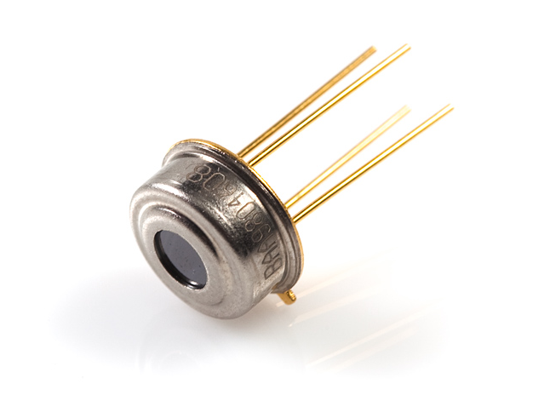
Temperature Sensor

Slide 14
MLX90614 is an infrared thermometer designed for non-contact temperature sensing.
An internal 17-bit ADC and a powerful DSP contribute to the MLX90614's high accuracy and resolution.
It has a huge number of applications including body temperature measurement and movement detection.
The MLX90614 provides two methods of output: PWM and SMBus (i.e. TWI, I²C). The 10-bit PWM output provides a resolution of 0.14°C, while the TWI interface has a resolution of 0.02°C.
The MLX90614 is factory calibrated in wide temperature ranges: -40 to 85°C for the ambient temperature and -70 to 382.2°C for the object temperature.
The measured value is the average temperature of all objects in the Field Of View of the sensor. The MLX90614 offers a standard accuracy of 0.5°C around room temperatures.

Slide 15
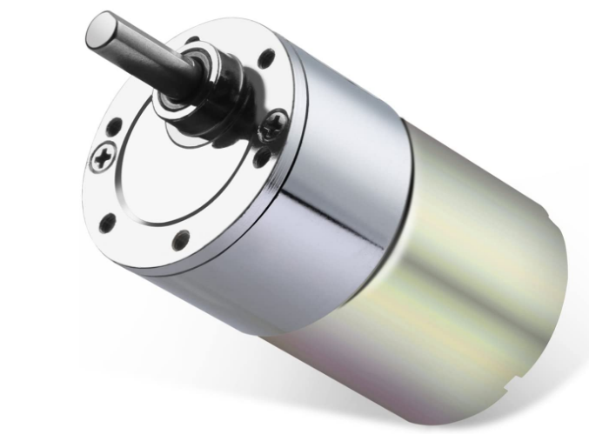
DC Motor

Slide 16
Working:
An electric motor is a device used to convert electricity into mechanical energy—opposite to an electric generator. They operate using principles of electromagnetism, which shows that a force is applied when an electric current is present in a magnetic field. Motors are used for several applications.
Specifications:
Rated Voltage: 12V
Speed: 10RPM
Material: Metal
Rated Torque: 15Kg.cm
Reduction Ratio: 1:314
Rated Current: 0.05A
D Shaped Output Shaft Size: 6*14mm (0.24" x 0.55") (D*L)
Gearbox Size: 37 x 31mm (1.46" x 1.22") (D*L)
Motor Size: 36.2 x 33.3mm (1.43" x 1.31") (D*L)
Mounting Hole Size: M3 (not included)

Slide 17
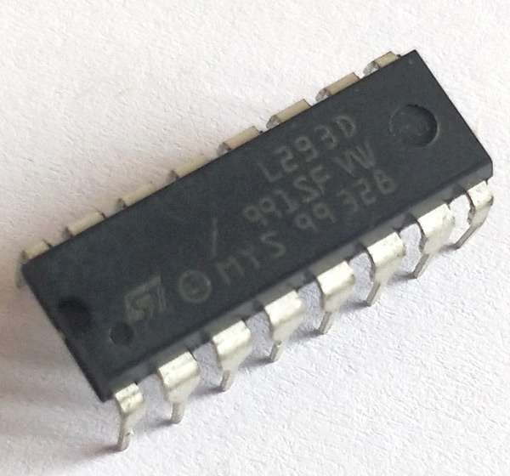
MOTOR DRIVER

Slide 18
L293D is quadruple high-current half-H drivers.
The L293D is designed to provide bidirectional drive currents of up to 600-mA at voltages from 4.5 V to 36 V.
It is designed to drive inductive loads such as relays, solenoids, DC and bipolar stepping motors, as well as other high-current/high-voltage loads in positive supply applications.
L293D is characterized for operation from 0°C to 70°C.
Specifications:
Wide Supply-Voltage Range: 4.5 V to 36 V
Separate Input-Logic Supply
Internal ESD Protection
High-Noise-Immunity Inputs
Output Current 600 mA Per Channel
Peak Output Current 1.2 A Per Channel
Output Clamp Diodes for Inductive Transient Suppression

Slide 19
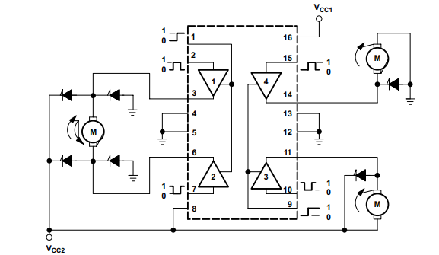
Block diagram:

Slide 20
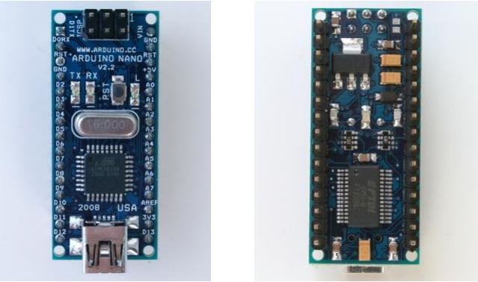
Arduino nano

Slide 21
The Arduino Nano is a small, complete, and breadboard-friendly board based on the ATmega328 (Arduino Nano 3.0).
It lacks only a DC power jack, and works with a Mini-B USB cable instead of a standard one.
The Nano was designed and is being produced by Gravitech.
Specifications:
Microcontroller Atmel ATmega328.
Operating Voltage (logic level) 5 V
Input Voltage (recommended) 7-12 V
Input Voltage (limits) 6-20 V
Digital I/O Pins 14 (of which 6 provide PWM output)
Analog Input Pins 8

Slide 22
DC Current per I/O Pin 40 mA
Flash Memory 32 KB (ATmega328) of which 2 KB used by bootloader.
SRAM 1 2 KB (ATmega328)
EEPROM 1 KB (ATmega328)
Clock Speed 16 MHz
Dimensions 0.73" x 1.70"

Slide 23
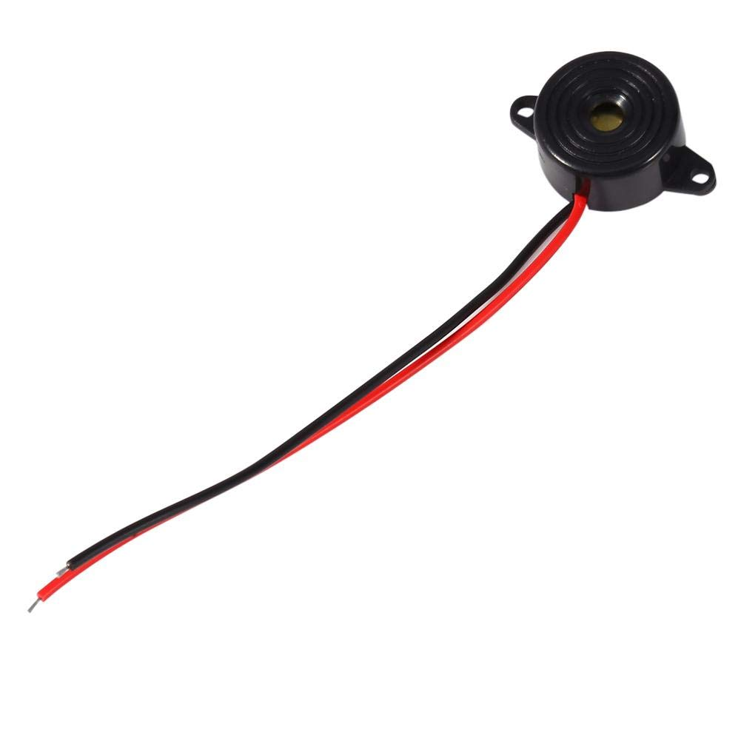
BUZZER

Slide 24
A buzzer or beeper is an audio signalling device, which may be mechanical, electromechanical, or piezoelectric (piezo for short).
Typical uses of buzzers and beepers include alarm devices, timers, and confirmation of user input such as a mouse click or keystroke.
Specifications:
Color: Black
Diameter: 23mm
Height: 12mm
Cable Length: 100mm
Sound Pressure Level: 85 to 95 decibels
Rated Voltage: 12VDC
Working Voltage Range: 3V-24V
Max Current: 10mA

Slide 25
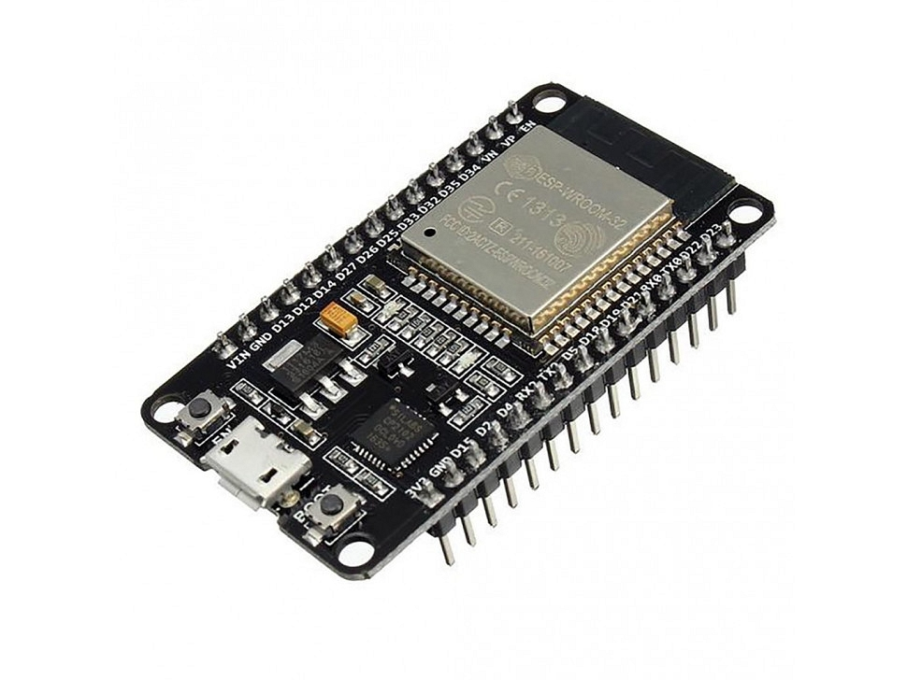
WIFI MODULE

Slide 26
ESP32 is a series of low-cost, low-power system on a chip microcontrollers with integrated Wi-Fi and dual-mode Bluetooth.
The ESP32 series employs a Tensilica Xtensa LX6 microprocessor in both dual-core and single-core variations and includes built-in antenna switches, RF balun, power amplifier, low-noise receive amplifier, filters, and power-management modules.
ESP32 is created and developed by Espressif Systems, a Shanghai-based Chinese company, and is manufactured by TSMC using their 40 nm process.
It is a successor to the ESP8266 microcontroller
Wi-Fi Key Features
802.11 b/g/n
• 802.11 n (2.4 GHz), up to 150 Mbps
4 × virtual Wi-Fi interfaces.
Antenna diversity

Slide 27
BT Key Features
Compliant with Bluetooth v4.2 BR/EDR and BLE specifications
Class-1, class-2 and class-3 transmitter without external power amplifier
Enhanced Power Control
+12 dBm transmitting power
NZIF receiver with –94 dBm BLE sensitivity
Adaptive Frequency Hopping (AFH)
Standard HCI based on SDIO/SPI/UART
High-speed UART HCI, up to 4 Mbps
Bluetooth 4.2 BR/EDR BLE dual mode controller
Synchronous Connection-Oriented/Extended (SCO/eSCO)
CVSD and SBC for audio codec
Bluetooth Piconet and Scatternet
Multi-connections in Classic BT and BLE
Simultaneous advertising and scanning

Slide 28
CPU and Memory
Xtensa® single-/dual-core 32-bit LX6 microprocessor(s), up to 600 MIPS (200 MIPS for ESP32-S0WD/ESP32- U4WDH, 400 MIPS for ESP32-D2WD)
448 KB ROM
520 KB SRAM
16 KB SRAM in RTC
QSPI supports multiple flash/SRAM chips
Clocks and Timers
Internal 8 MHz oscillator with calibration
Internal RC oscillator with calibration
External 2 MHz ~ 60 MHz crystal oscillator (40 MHz only for Wi-Fi/BT functionality)
External 32 kHz crystal oscillator for RTC with calibration

Slide 29
Advanced Peripheral Interfaces
34 × programmable GPIOs
12-bit SAR ADC up to 18 channels
2 × 8-bit DAC
10 × touch sensors
4 × SPI
2 × I²S
2 × I²C
3 × UART
1 host (SD/eMMC/SDIO)
1 slave (SDIO/SPI)
Ethernet MAC interface with dedicated DMA and IEEE 1588 support
CAN 2.0
IR (TX/RX)
Motor PWM
LED PWM up to 16 channels

Slide 30
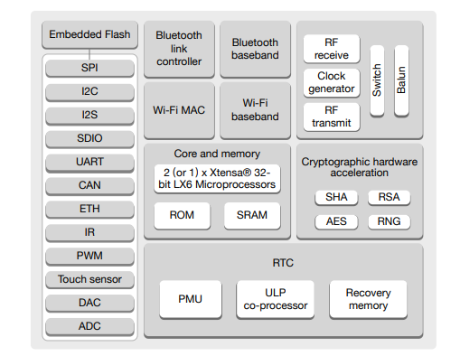
Block diagram

Slide 31
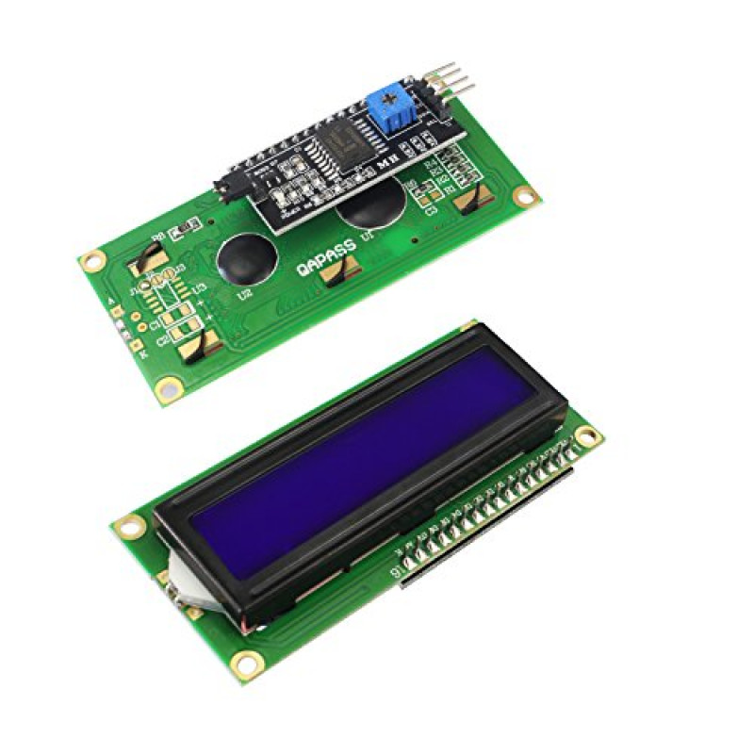
LCD DISPLAY

Slide 32
This is LCD16x2 Parallel LCD Display that provides a simple and cost-effective solution for adding a 16×2 White on RGB Liquid Crystal Display.
The display is 16 character by 2-line display has a very clear and high contrast white text upon a blue background/backlight.
Specifications
Operating Voltage is 4.7V to 5.3V
Current consumption is 1mA without backlight
Alphanumeric LCD display module, meaning can display alphabets and numbers
Consists of two rows and each row can print 16 characters.
Each character is built by a 5×8-pixel box
Can work on both 8-bit and 4-bit mode
It can also display any custom generated characters
Available in Green and Blue Backlight

Slide 33
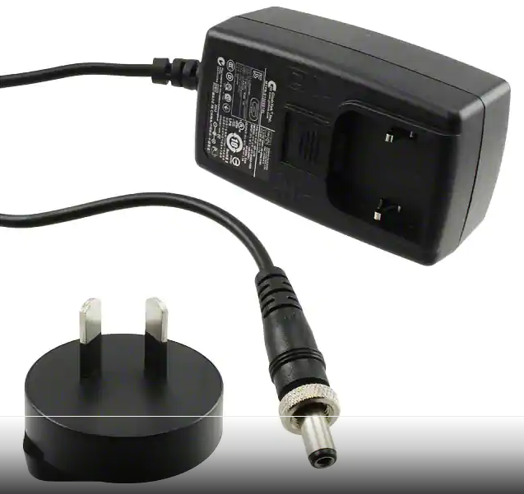
Wall Mount Adapter

Slide 34
A power supply for electronic devices.
Also called an "AC adapter" or "charger," power adapters plug into a wall outlet and convert AC to a single DC voltage.
Specifications:
Voltage input – 100 ~ 240 VAC
Voltage output - 9V
Current output – 1.7A
Power – 15 W

Slide 35
References
Links to datasheets of hardware used are provided below:
https://media.digikey.com/pdf/Data%20Sheets/Seeed%20Technology/102110001_Web.pdf
https://cdn.sparkfun.com/datasheets/Sensors/Proximity/HCSR04.pdf
https://www.sparkfun.com/datasheets/Sensors/Temperature/SEN-09570-datasheet-3901090614M005.pdf
https://www.amazon.com/Greartisan-Electric-Reduction-Eccentric-Diameter/dp/B071XCWM2J?th=1
https://www.ti.com/lit/ds/symlink/l293.pdf
http://www.farnell.com/datasheets/1682238.pdf
https://www.amazon.ca/3-Pack-3V-24V-Electric-Buzzer-Active/dp/B0761WSXDK
https://www.espressif.com/sites/default/files/documentation/esp32_datasheet_en.pdf
https://www.digikey.ca/en/products/detail/matrix-orbital/MOP-AL162A-BYFY-25J-3IN/9602838
https://media.digikey.com/pdf/Data%20Sheets/Multi-Tech%20Systems%20PDFs/Accessories_Gde.pdf

Slide 36
Thank You

